Slide 1
From Dwarfs to Spirals: Chemical Evolution of Galaxies Across Stellar Mass and the Implications for Nucleosynthesis
James W. Johnson
The Ohio State University
PhD Defense
July 14, 2023

Slide 2
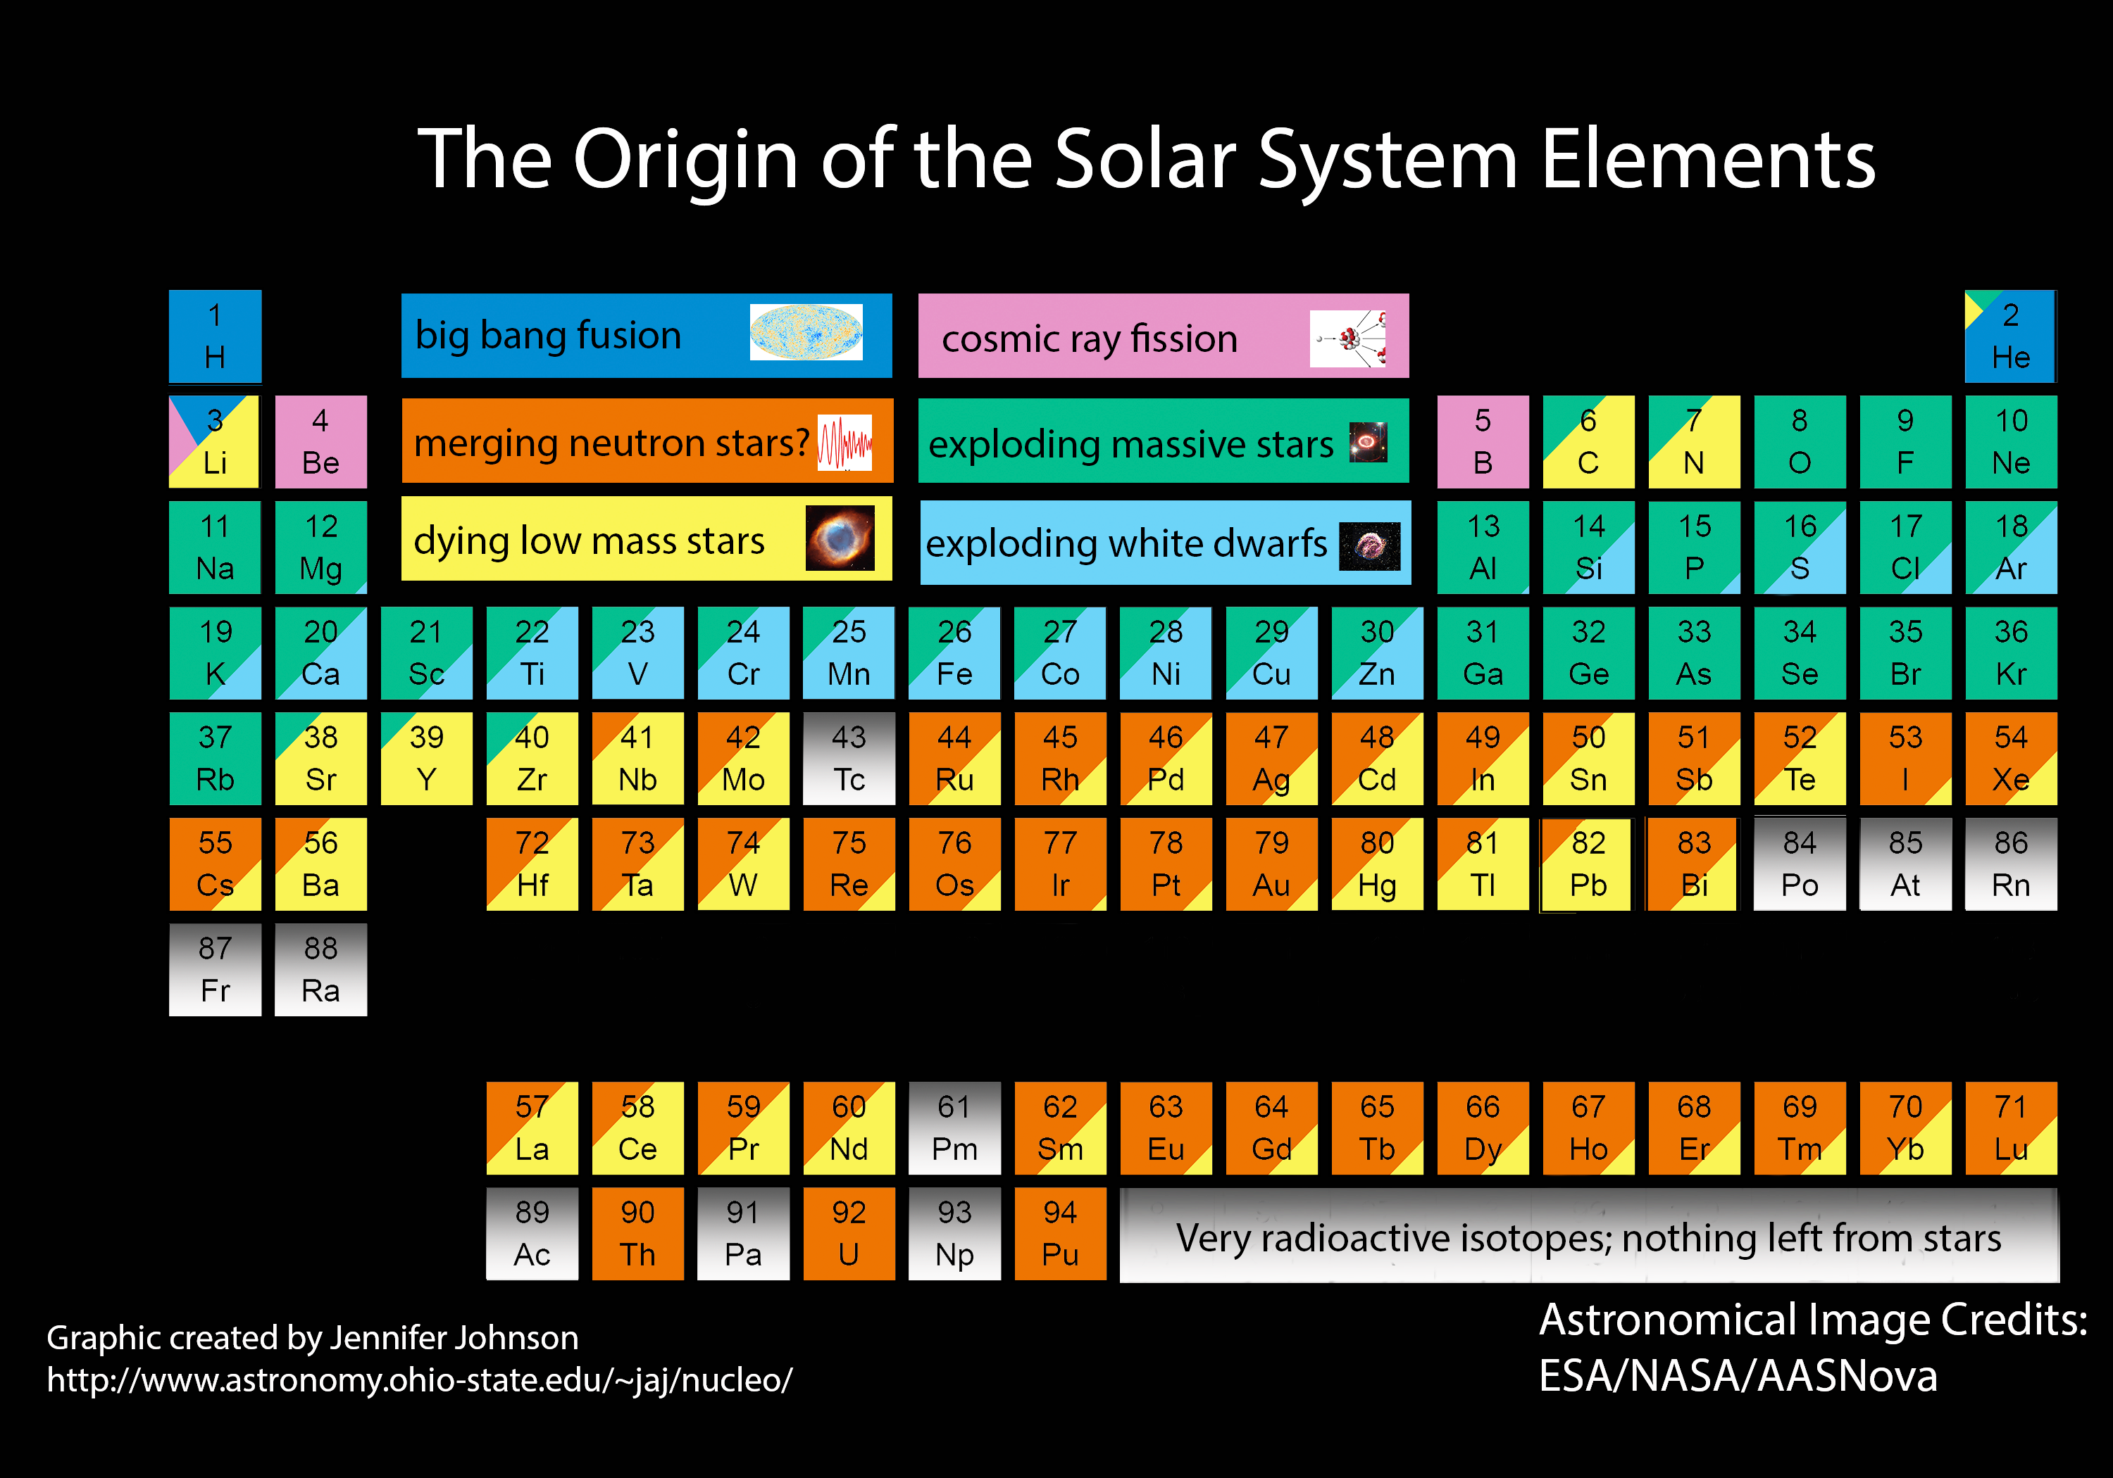
In the beginning, there was only H, He, and Li
Everything else was made in stars

Slide 3
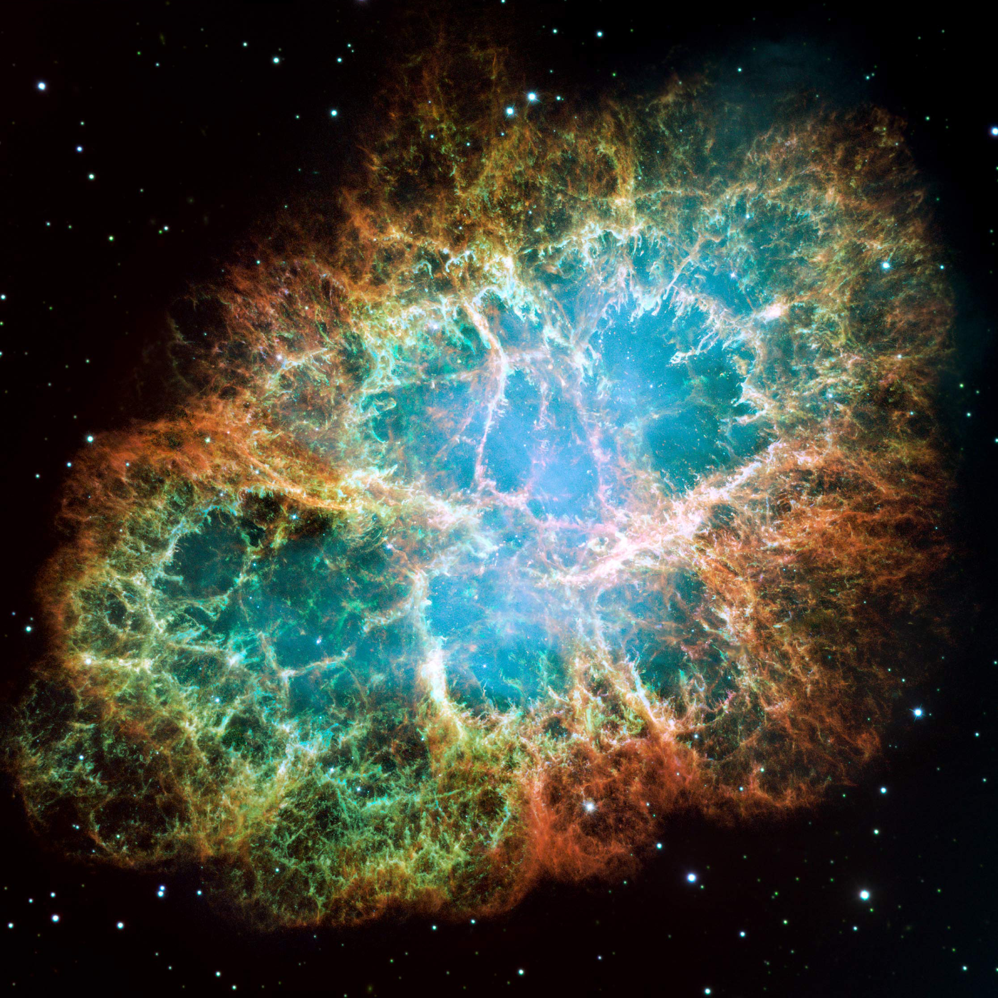
Massive Stars
>8 Solar masses
Fusion up to ⁵⁶Fe
Core Collapse can produce supernova
Products: O, Ne, & Mg up to Sr, Y, Zr
Image credit: NASA
Notes:
Image is of the crab nebula

Slide 4
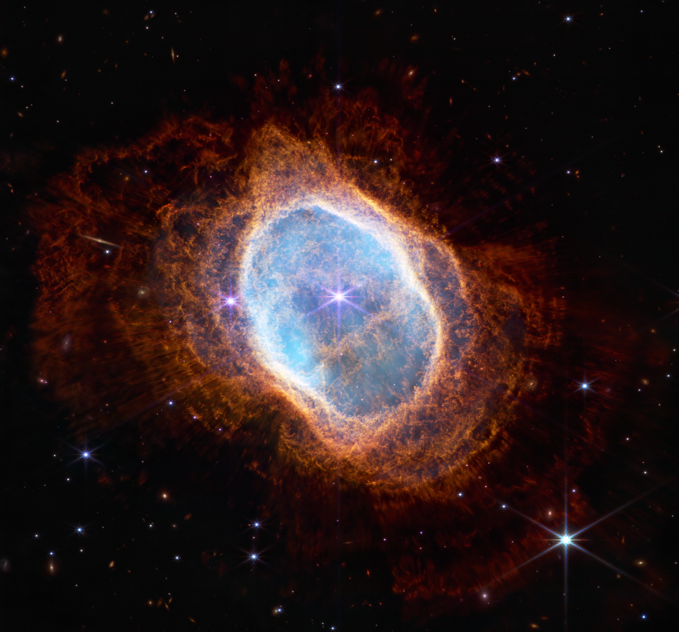
Low Mass Stars
<8 Solar masses
Produce C/O core and expel outer layers
Products: He, Li, C, N, Sr, Y, Zr, and up
Remnant: White Dwarf
Image credit: NASA
Notes:
Image is of NGC 3132.

Slide 5
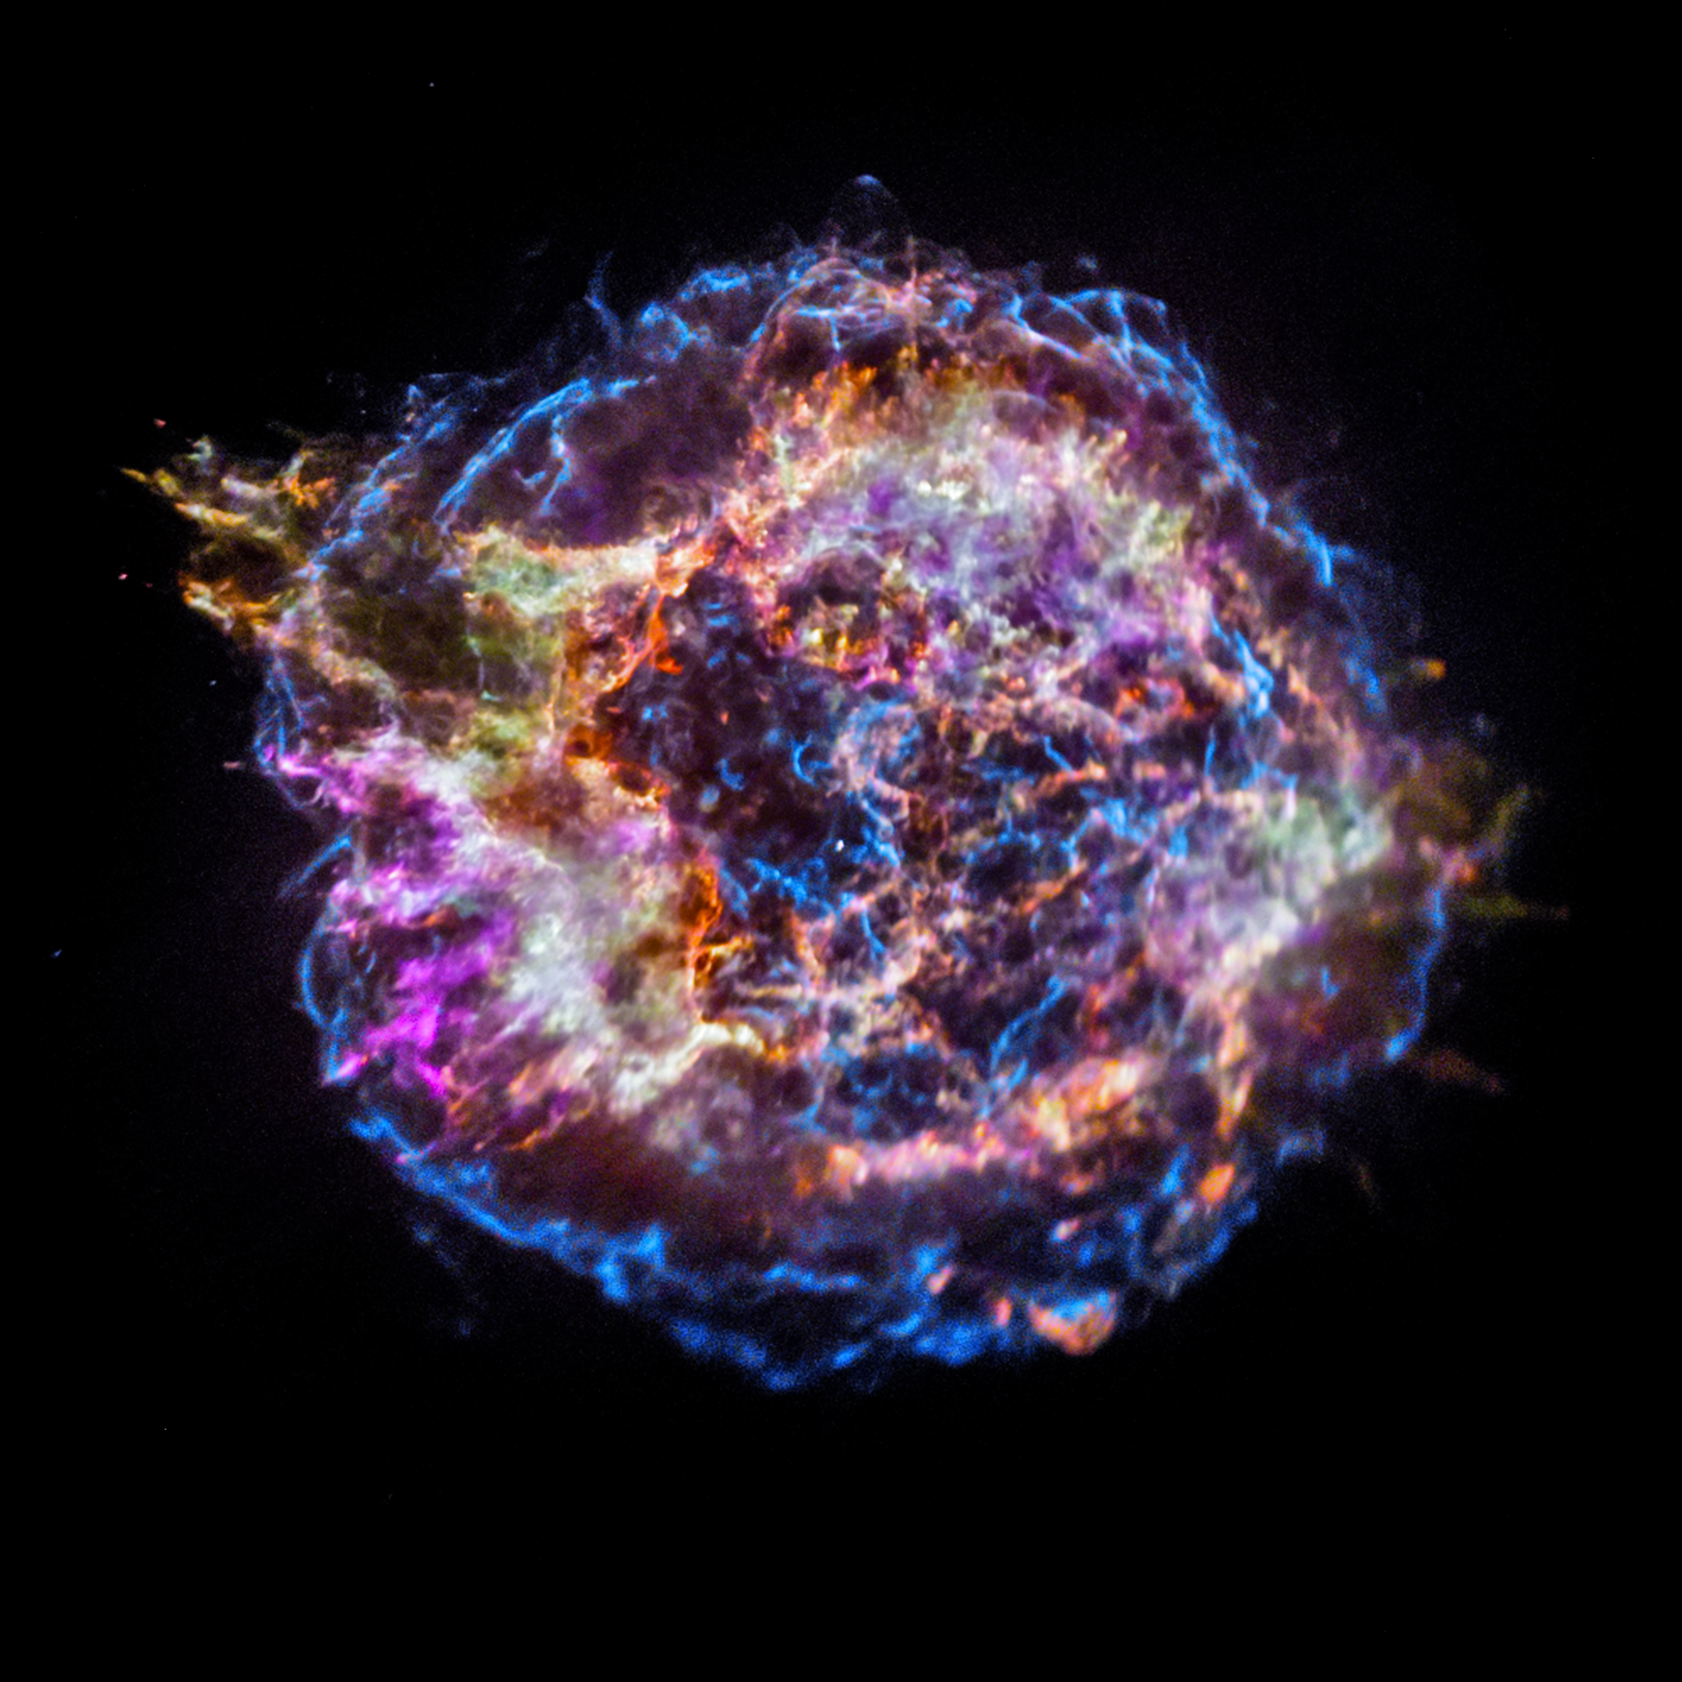
White Dwarf Supernovae
Classically: occurs when WD reaches 1.4 solar masses
Explosion mechanism poorly understood
Products: Ca, Ti, Mn, Fe, Co, Ni, Zn
Image credit: NASA
Notes:
Image is of Cassiopeia A.

Slide 6



Galaxies facilitate nuclear processing
Star Formation
Accretion
Outflows
KABOOM!
Supernovae

Slide 7
How to make sense of it all?
Enter galactic chemical evolution models…

Slide 8
One-Zone
Multi-Zone
One chemically homogeneous gas cloud
Multiple clouds
Accretion & Ejection
KABOOM!
KABOOM!
Exchange of Gas & Stars
KABOOM!
New Stars
Metals
KABOOM!

Slide 9

Supernovae (Core Collapse, Type Ia)
Asymptotic Giant Branch Stars (low mass)
Recycled stellar envelopes
net production rate = $∑$ sources - $∑$ sinks
Star Formation
Outflows
Gas Flows

Slide 10

Versatile Integrator for Chemical Evolution
Workhorse for integrating models
Input: Galaxy evolution parameters
Star formation history
Stellar yields
Gas and star exchange
Output: Elemental abundances
Gas at all timesteps in all zones
Every stellar population

